Slide 1
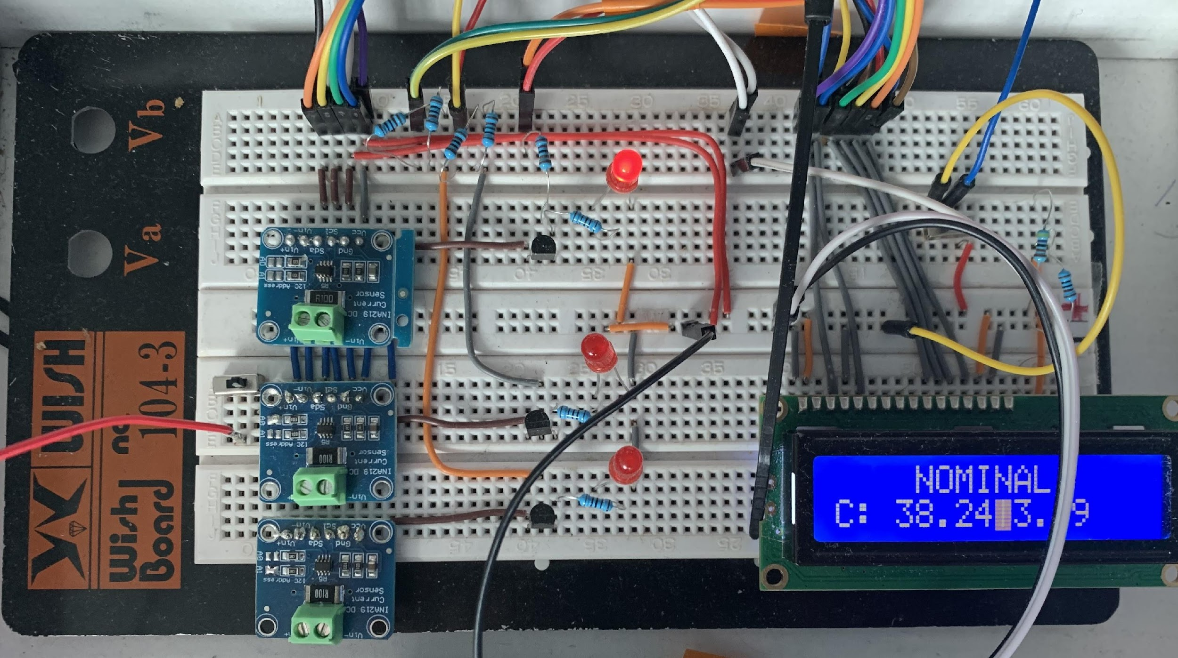
Title slide + symbol #1
Smart Charge
SEmS Smart Battery
Joep Raithel, Ben Cornelisse, Arnout Dourleijn, Mario Padron

Slide 2
Quote
Designing for safety and redundancy when using batteries in hazardous environments

Slide 3
System Requirements
REQ-SYS-001 | The system shall measure the capacity of a single battery cell.
REQ-SYS-002 | The system shall include a state-of-charge (SOC) estimation algorithm to provide accurate battery charge status.
REQ-SYS-003 | The system shall measure the voltage of an individual battery cell.
REQ-SYS-004 | The system shall measure the output current of the battery.
REQ-SYS-005 | The system shall measure the temperature of an individual battery cell.
REQ-SYS-006 | The system shall include a current limitation mechanism to prevent excessive current flow.
REQ-SYS-007 | The system shall prevent currents larger than -50 mA from flowing back into the battery system.
REQ-SYS-008 | The system shall be able to control the power supply to the loads, allowing or shutting down power as needed.
REQ-SYS-009 | The Battery Management System shall be powered by an independent source.
REQ-SYS-010 | The system shall contain an LCD display that showcases important messages
REQ-SYS-011 | The system shall use an Arduino UNO board as the microcontroller.
WISH-SYS-003 | The system shall incorporate redundancy into each wiring connection to ensure reliability and fault tolerance.

Slide 4
Safety & Redundancy Requirements
REQ-SAF-001 | The system shall contain an overvoltage protection mechanism to prevent damage.
REQ-SAF-002 | The system shall detect if the voltage of the battery is too low.
REQ-SAF-002 | The system shall be able to estimate the battery health accurately even if one current sensor fails.
REQ-SAF-003 | The system shall include an emergency shutdown feature that can be activated in the event of critical failures.
REQ-RED-001 | The current and voltage measuring system shall contain no single points of failure
REQ-RED-004 | The system shall shutdown in case of excessive temperature.
REQ-RED-002 | The system shall identify and report faults within the battery or its components.
REQ-ML-001 | The system shall feature machine learning algorithms to estimate state of charge

Slide 5
LCD Display Requirements
REQ-LCD-001 | The LCD Display shall alternate between different screens to showcase all relevant information.
REQ-LCD-002 | The LCD Display shall showcase the operational mode (nominal, fault, or error).
REQ-LCD-003 | The LCD Display shall showcase the current through each current sensor during nominal operation
REQ-LCD-004 | The LCD Display shall showcase the voltage measured by each current sensor during nominal operation
REQ-LCD-005 | The LCD Display shall showcase the SoC estimation during nominal operation
REQ-LCD-006 | The LCD Display shall showcase the detected faults or errors.
REQ-LCD-007 | The LCD Display shall be powered by the Arduino Boards

Slide 6
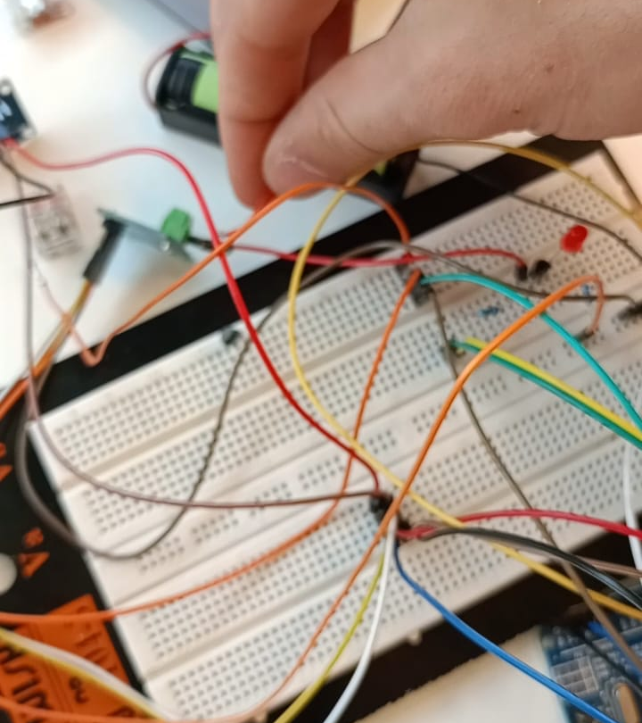
The design process
1st Iteration:
Single Arduino board
Single LED always on
Single Current Sensor

Slide 7
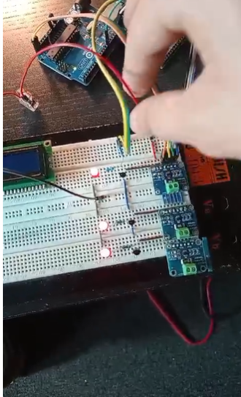
The design process
1st Iteration:
Single Arduino board
Single LED always on
Single Current Sensor
2nd Iteration:
Single Arduino board
3 LED’s Controlled as a group
3 Current Sensors

Slide 8
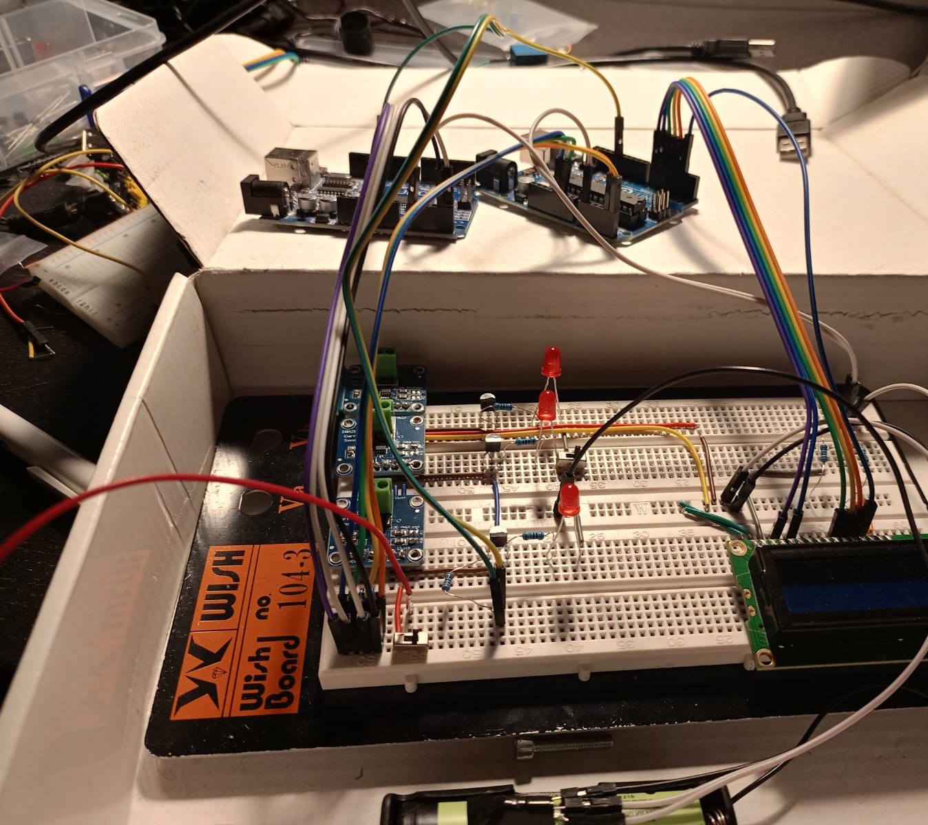
The design process
1st Iteration:
Single Arduino board
Single LED always on
Single Current Sensor
2nd Iteration:
Single Arduino board
3 LED’s Controlled as a group
3 Current Sensors
3rd Iteration:
2 Arduino boards
3 LED’s Individually Controlled
3 Current Sensors
LCD Display

Slide 9
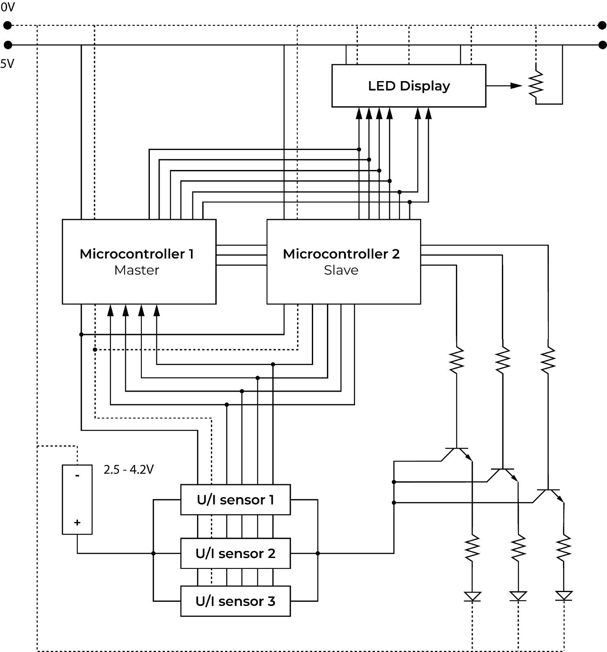
Hardware of Our System
Redundancy
Hot Swap Master Slave Arduino
Majority Voting U/I Sensors
Redundant Wiring
2000 Ohm
100 Ohm

Slide 10
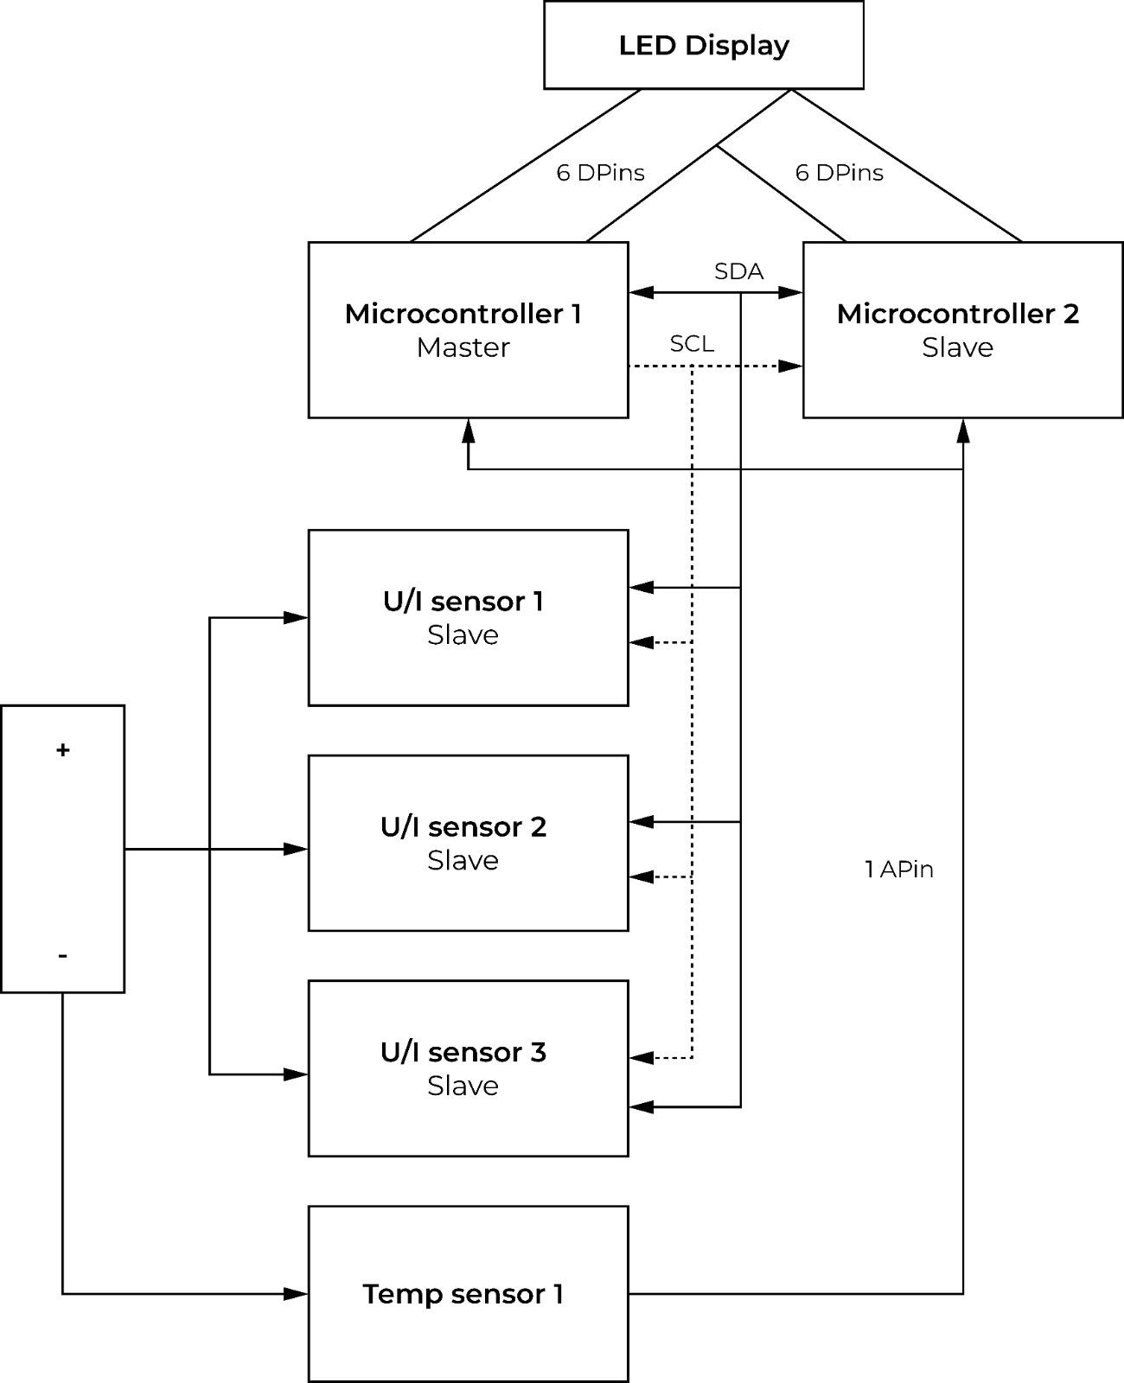
Software Of Our System
Features
SDA for Master, Slave Arduino’s and UI Sensors
SCL for Master to Slave Communication
1 Apin To Temperature Sensors
Watchdog timer
Interrupts

Slide 11
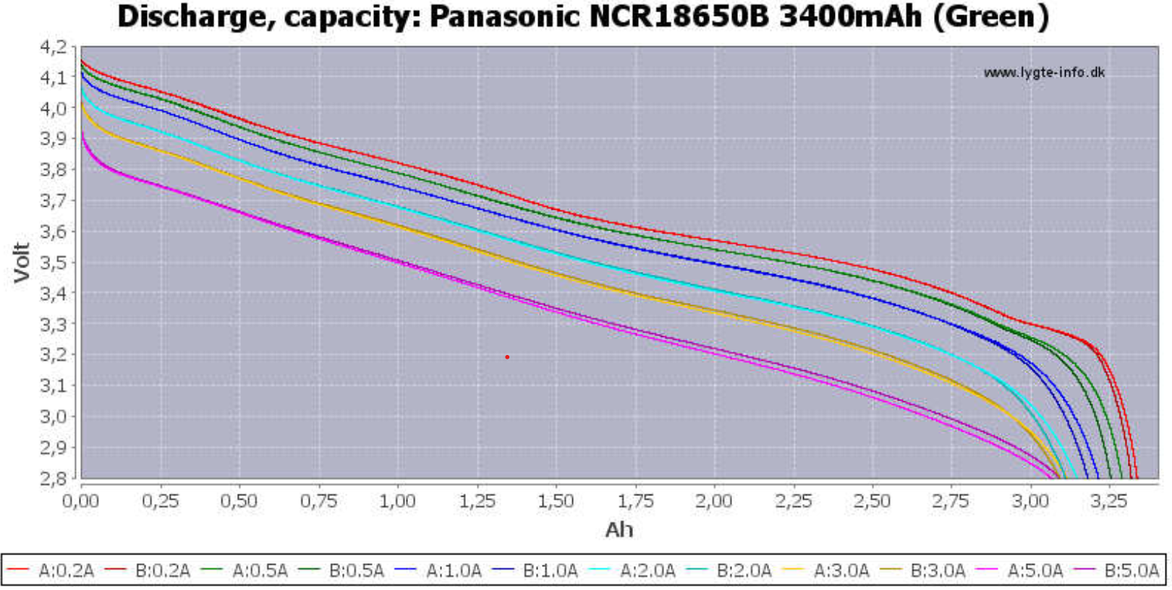
Machine Learning Implementation
Manually Labeled Dataset from Datasheet
Random Forest Regressor

Slide 12
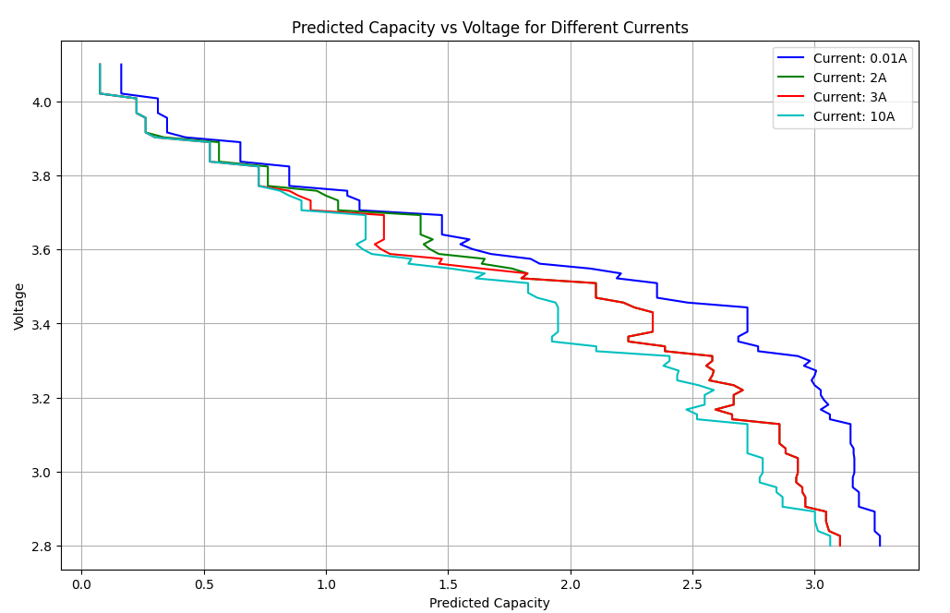
Comparing Our Model To The Data
Small Manually Labeled Dataset

Slide 13
Machine Learning Results
Findings
Makes predictions on unseen values
Follows the shape of the charge
Improvements
Blocky Signal: Too Small Data Set, add smoothing
More Data Points on non-linear parts
Better method for data collection

Slide 14
Adaptation to real life scenarios
Redundant temperature sensors and battery cells
Add more current flow safety measures like Diodes and Transistors
Shielding case to protect against radiation
Use hardware better suited for a space application: FPGA instead of a microcontroller
More advanced machine learning technique that does for example fault prediction

Slide 15
Afsluiter
Thank you for
Your Attention
Joep Raithel, Ben Cornelisse,
Arnout Dourleijn, Mario Padron

